Slide 1
ANC3 PAC MAN!!! 2nd Iteration Hugo Barbachano & Tidiane Toure

Slide 2
Analysis

Slide 3
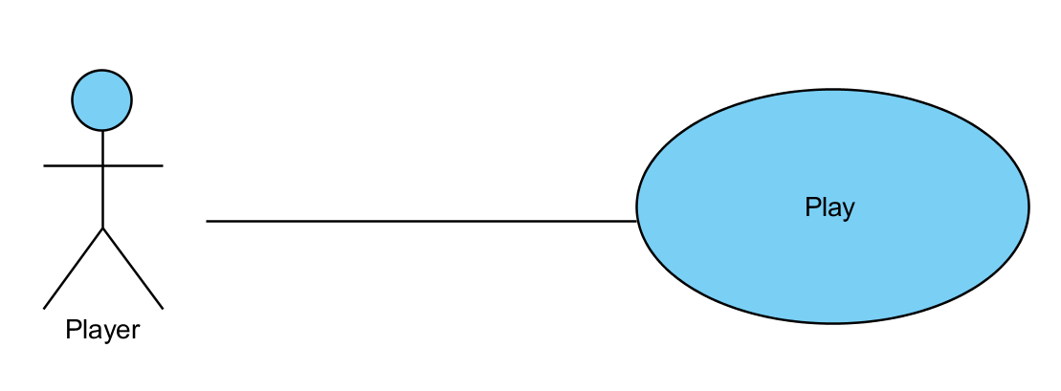
Use Case Diagram

Slide 4
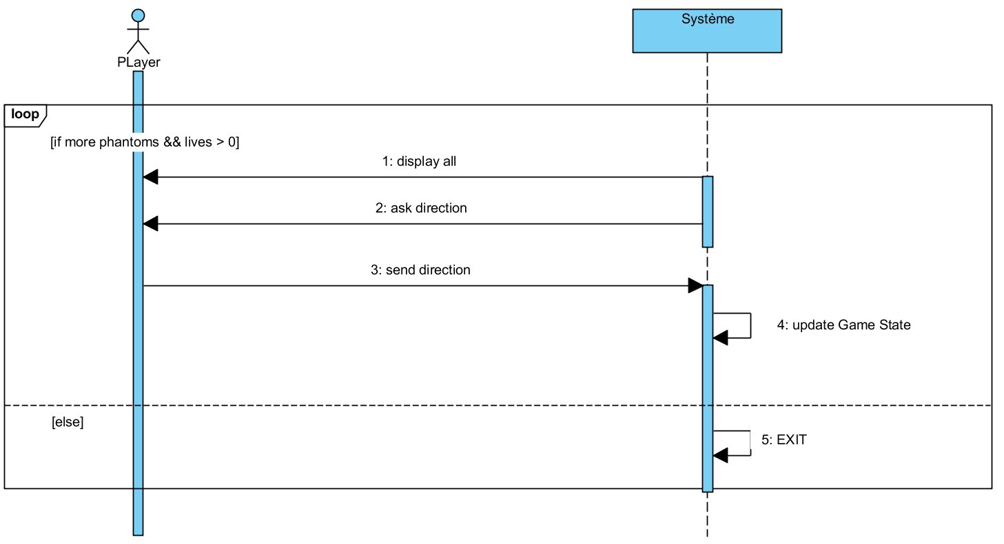
DSS Play

Slide 5
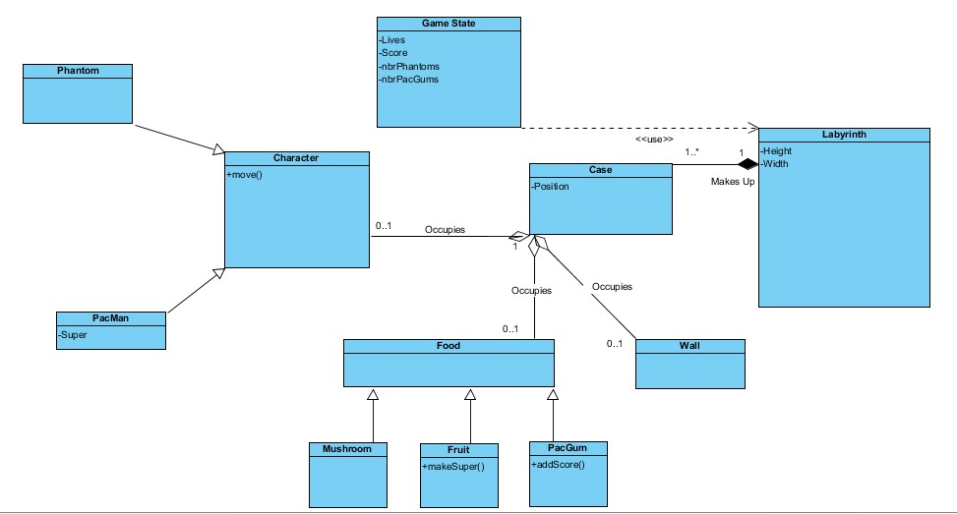
Domain Classes

Slide 6
Conception

Slide 7
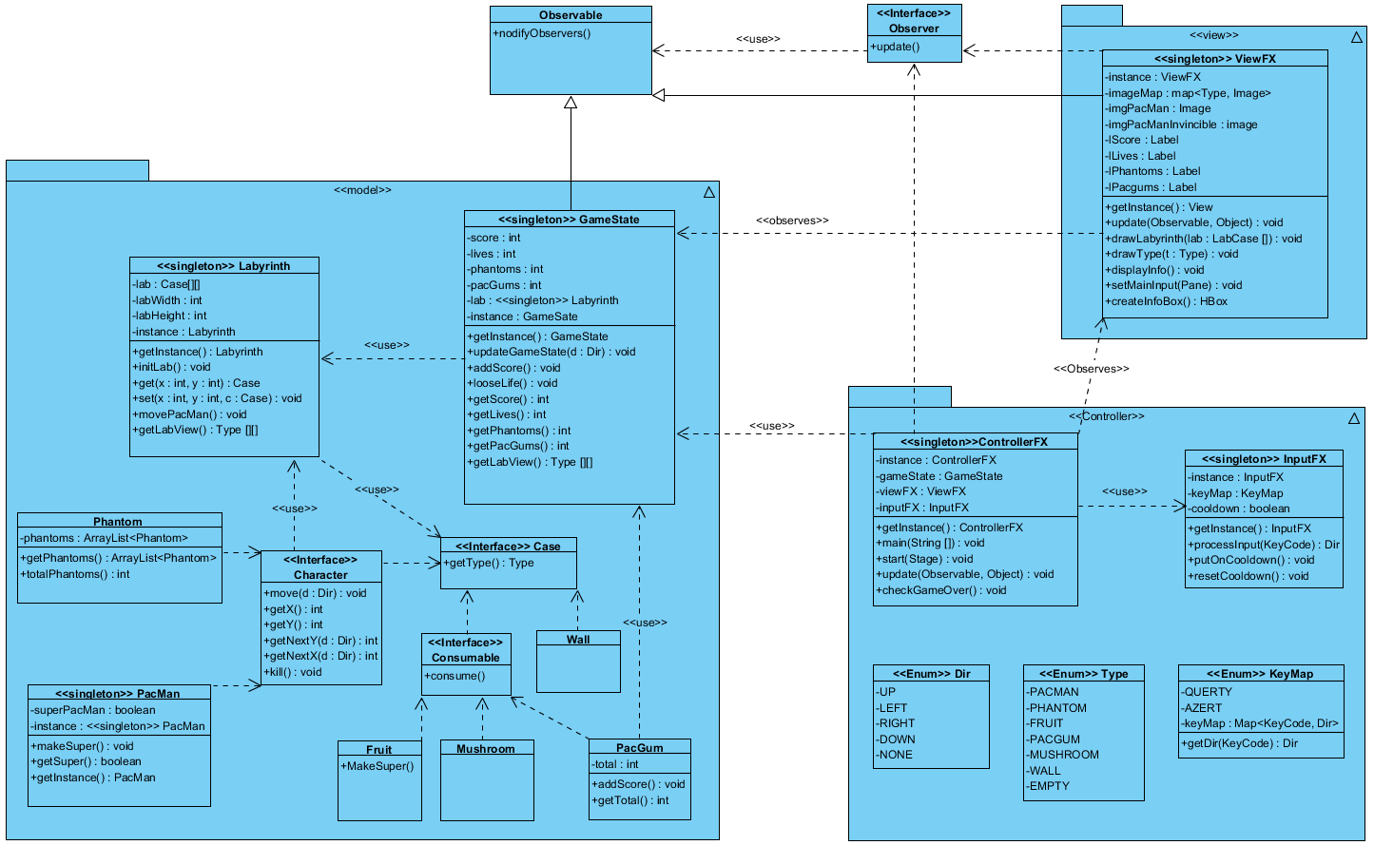
Software Classes (with JavaFX)

Slide 8
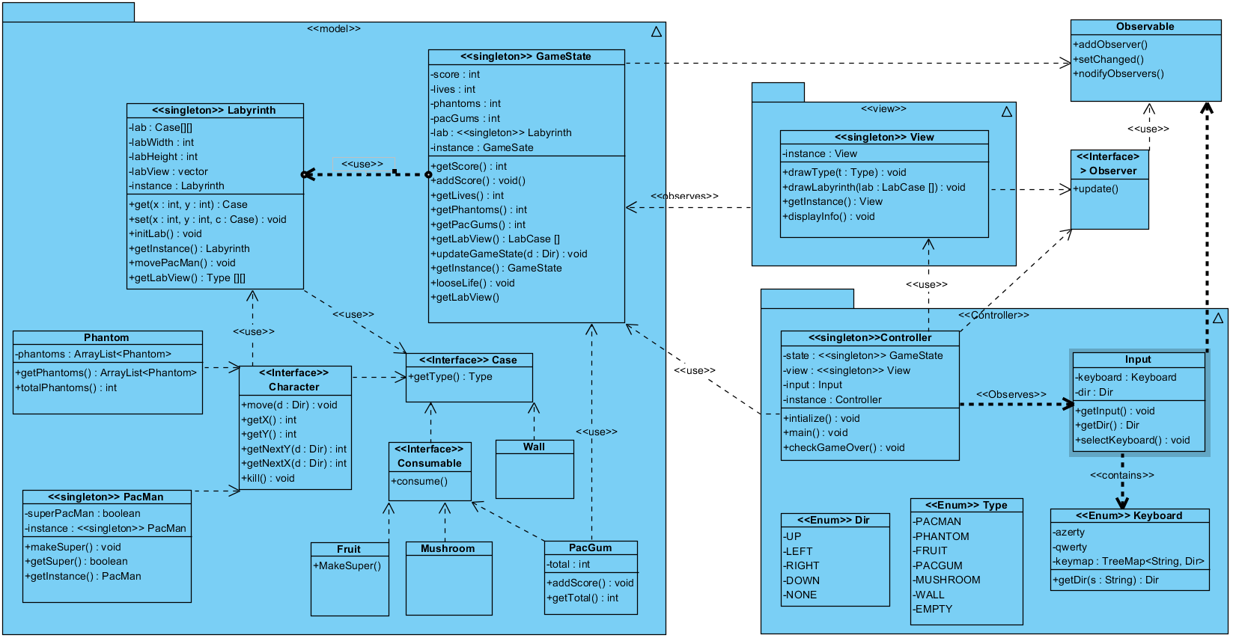
Software Classes (with console)

Slide 9
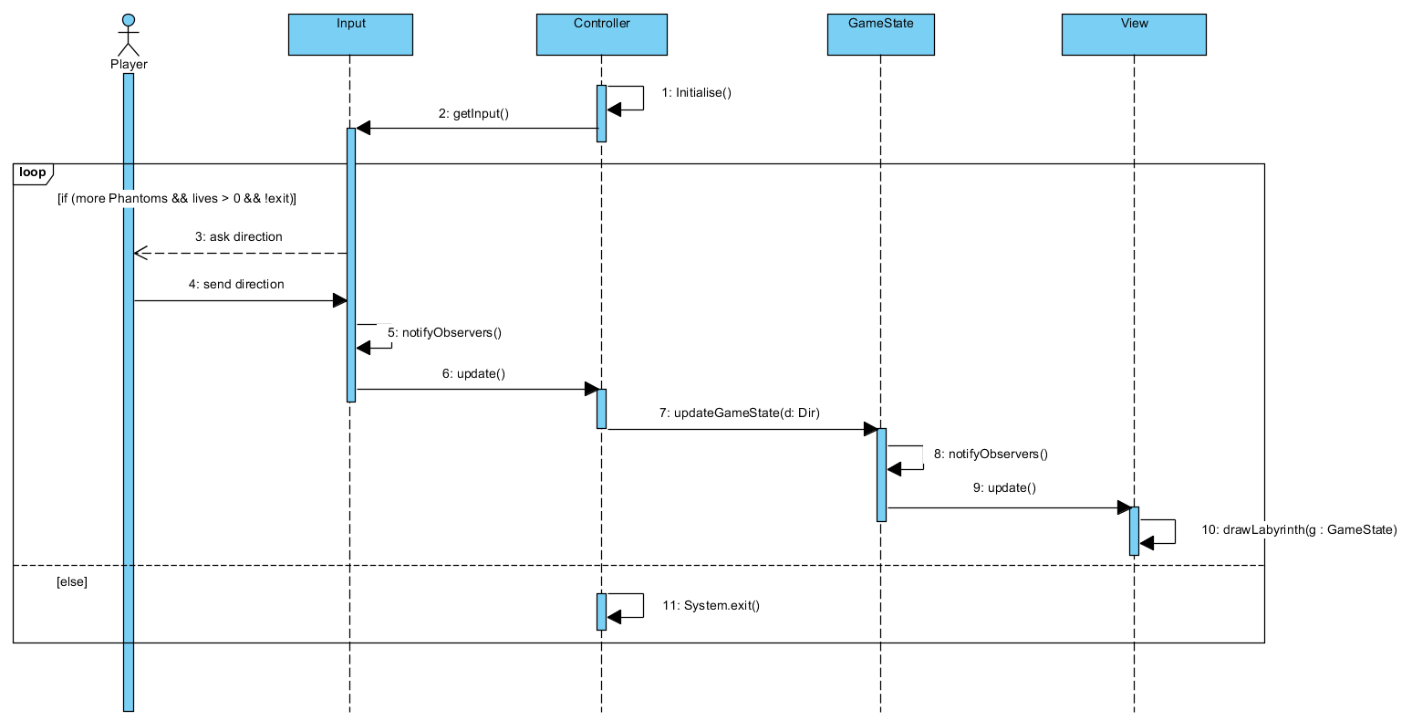
DS Play

Slide 10
Readme
Main Game Loop
In its main() the ControllerFX creates all the objects, sets itself as an observer of ViewFX and sets ViewFX as an observer of GameState.
Then the ControllerFX calls GameState.updateGameState(Dir) which runs an infinite loop:
{
1 – ViewFX gathers the key press and notifies ControllerFX.
2 - In its update() ControllerFX processes the input with InpuFXt.proccessInput(KeyCode) and calls GameState.updateGameState(Dir).
3 - In updateGameState() GameState handles the movement and notifies the ViewFX.
4 - ViewFX gets a Type[][] copy of the labyrinth as a parameter in its update() and draws the game based on that.
5 – The ControllerFX calls Platform.exit() if the conditions for Game Over or Win are met or if the player types “x”.
}

